Slide 1

在崇拜之前
−請安靜準備您敬拜的心。
−讓您的通信器材進入
silent mode

Slide 2
宣 召 Invocation
詩篇 Psalm 126:1-6

Slide 3
126:1〔上行之詩。〕當耶和華將那些被擄的 帶回錫安的時候、我們好像作夢的人。
126:2我們滿口喜笑、滿舌歡呼的時候、外邦中就有人說、耶和華為他們行了大事。
126:1 It will be like a dream
when the Lord comes back with
the captives of Zion.
126:2 We will laugh and sing happy songs!
Then people in other nations will say,
"The Lord did a great thing for Zion!"

Slide 4
126:3耶和華果然為我們行了大事、我們就歡喜。
126:4耶和華阿、求你使我們被擄的人歸回、好像南地的河水復流。
126:3 Yes, the Lord will have done a great
thing for us, and we will be happy.
126:4 So Lord, bring back the good times,
like a desert stream filled again
with flowing water.
Notes:
4

Slide 5
126:5 流淚撒種的、必歡呼收割。
126:6 那帶種流淚出去的、必要歡歡樂樂的
帶禾捆回來。
126:5 Then those who were sad while
planting seeds will be happy
when they gather the crops!
126:6 And those who cried while
carrying the seeds will be happy
when they bring in the crops!
Notes:
5

Slide 6

使徒信經
I believe in God, the Father almighty,
creator of heaven and earth.
I believe in Jesus Christ, his only Son, our Lord.
He was conceived by the power of the Holy Spirit
and born of the virgin Mary.
我信上帝，全能的父
創造天地的主。
我信我主耶穌基督，
上帝的獨生子；
因著聖靈感孕，
從童貞女馬利亞所生

Slide 7
使徒信經
在本丟彼拉多手下受難
被釘在十字架上
受死，埋葬；
降在陰間
第三天從死裏復活；
升天，坐在全能父上帝的右邊；
He suffered under Pontius Pilate,
was crucified, died, and was buried.
He descended into hell.
On the third day
he rose again.
Ascended into heaven,
and is seated at the right hand of the Father.

Slide 8
使 徒 信 經
將來必從那裏降臨，
審判活人，死人。
我信聖靈；
我信聖而公之教會；
我信聖徒相通；
我信罪得赦免，
我信身體復活；
我信永生！
阿們
He will come again to judge the living and the dead.
I believe in the Holy Spirit, the holy Church, the communion of saints,
the forgiveness of sins,
the resurrection of the body, and the life everlasting.
Amen.

Slide 9
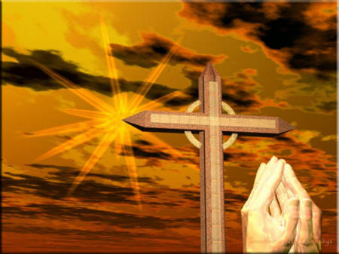
領 禱~Prayer
Notes:
9

Slide 10
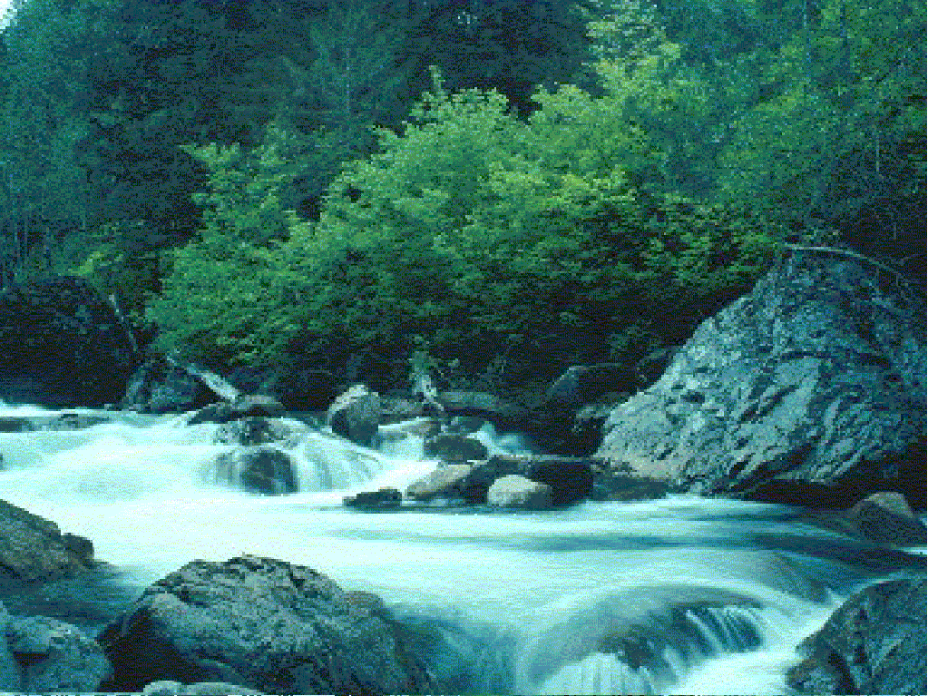
讚美Praise

Slide 11
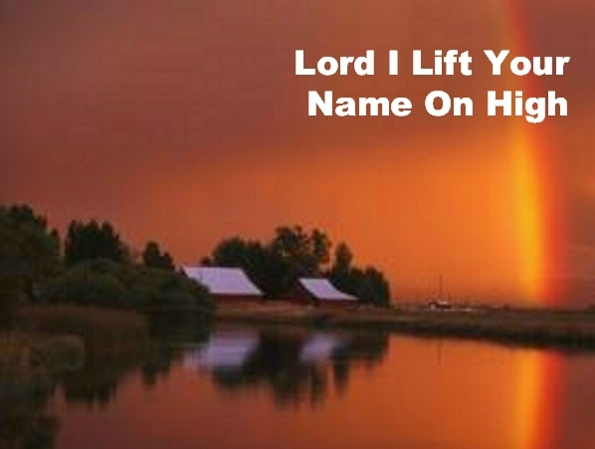
主我高舉你的名
主，我高舉你的名
主，我讚美你的聖名，
Lord, I lift your name on high,
Lord, I love to sing Your praises,

Slide 12
主我高舉你的名
感謝你作我的王
感謝你拯救我靈魂
I'm so glad You're in my life,
I'm so glad You came to save us,

Slide 13
主我高舉你的名
主，你從高天降臨、作我道路
捨生命背十架、償我罪債，
You came from heaven to earth,
to show the way,
From the earth to the cross,
my debt to pay,

Slide 14
主我高舉你的名
從十架進墳墓
從墳墓回高天
主，我高舉你的名。
From the cross to the grave,
from the grave to the sky,
Lord, I lift Your name on high!

Slide 15
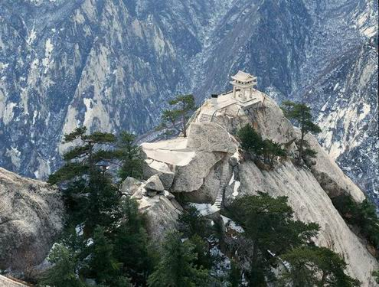
我要唱耶和華的大慈愛

Slide 16
我要唱耶和華的大慈愛
我要唱耶和華的大慈愛到永遠，
我要唱（我要唱）我要唱（我要唱）
我要唱耶和華的大慈愛到永遠，
我要唱耶和華的大慈愛，
I will sing of the mercies of the Lord forever,
I will sing (I will sing), I will sing (I will sing,)
I will sing of the mercies of the Lord forever, I will sing of the mercies of the Lord.

Slide 17
我要唱耶和華的大慈愛
用我口，（我口﹞叫人知道（知道）
你的信實，你的信實，
用我口，（我口）叫人知道，（知道）
你的信實直到萬代。
With my mouth (my mouth) will I make known (make known)
Thy faithfulness, Thy faithfulness,
With my mouth (my mouth)
will I make known (make known,
thy faithfulness to all generations.

Slide 18
我要唱耶和華的大慈愛
我要唱耶和華的大慈愛到永遠，
我要唱（我要唱）我要唱（我要唱）
我要唱耶和華的大慈愛到永遠，
我要唱耶和華的大慈愛，
I will sing of the mercies of the Lord forever,
I will sing (I will sing), I will sing (I will sing,)
I will sing of the mercies of the Lord forever, I will sing of the mercies of the Lord.

Slide 19
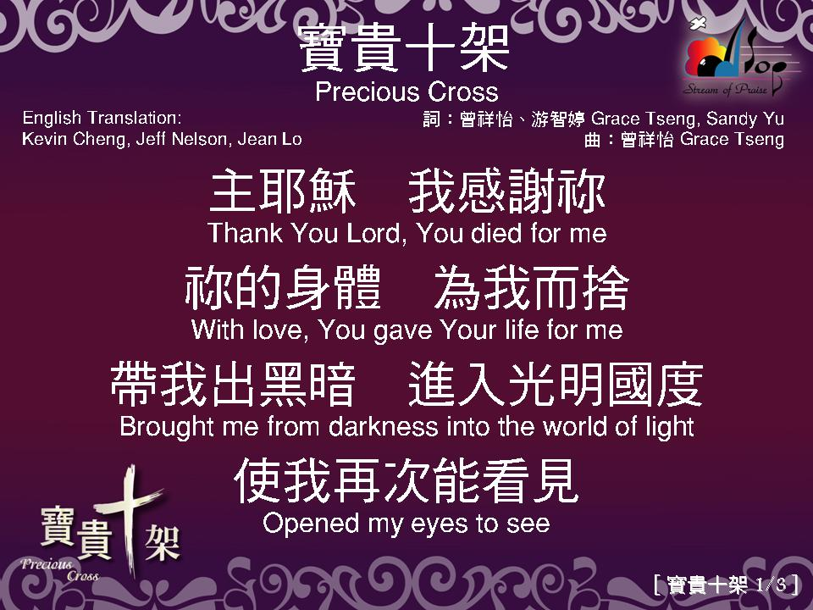

Slide 20
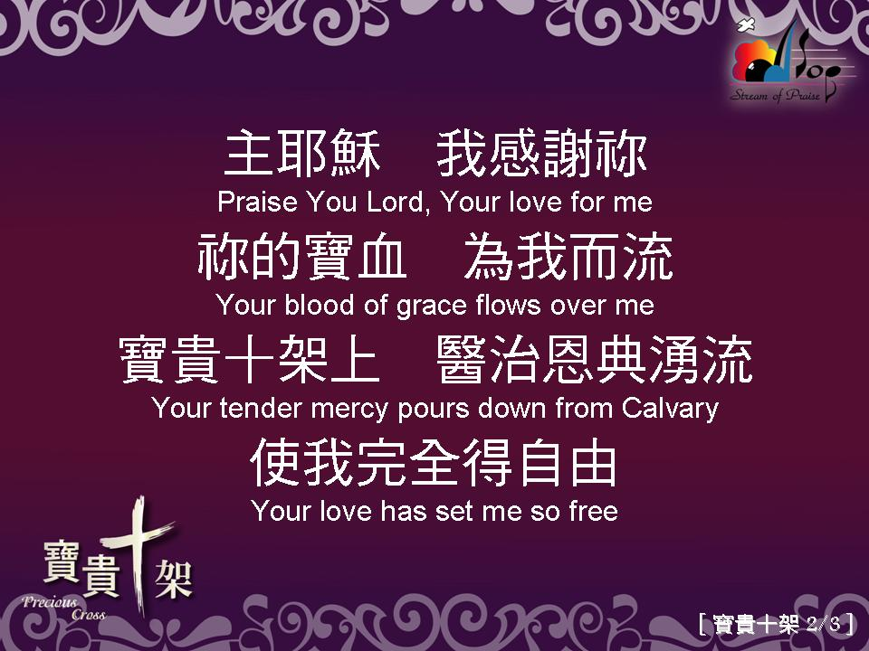

Slide 21
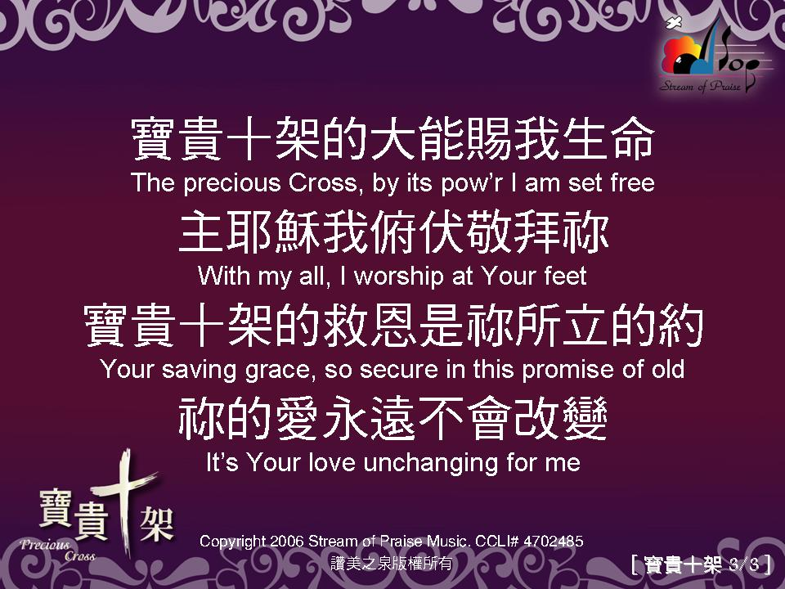

Slide 22
牧 禱 Pastor Prayer
Notes:
22

Slide 23
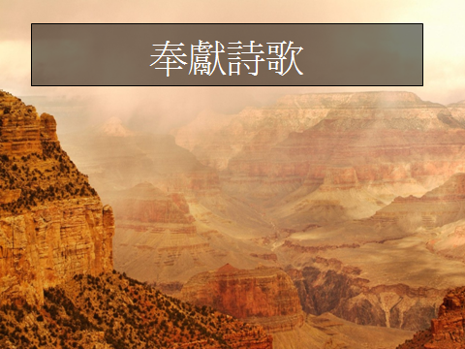
Notes:
23

Slide 24
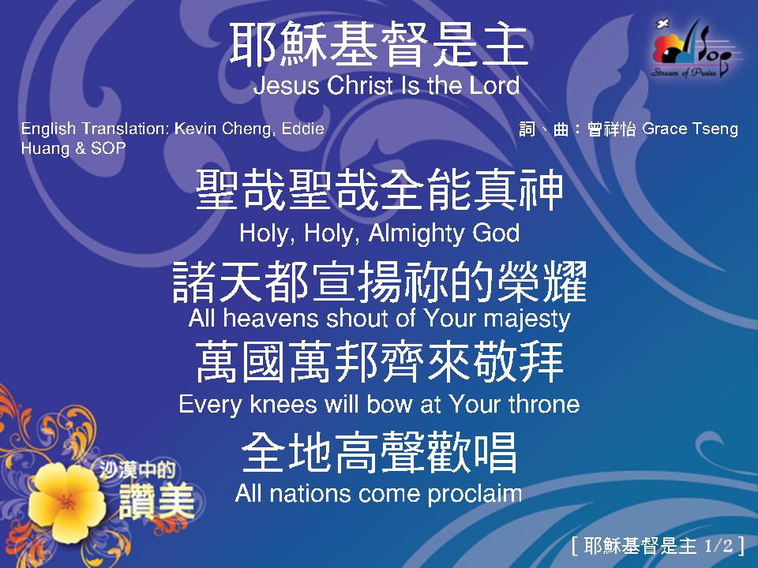

Slide 25
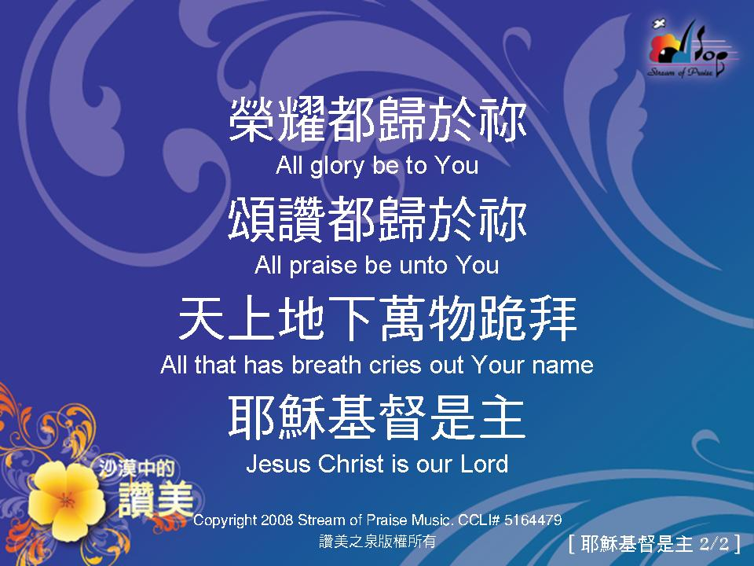

Slide 26

~聖餐 ~Communion ~
Notes:
26

Slide 27
11:23 - 我當日傳給你們的、原是從主領受的、就是主耶穌被賣的那一夜、拿起餅來、
11:24 - 祝謝了、就擘開、說、這是我的身體、為你們捨的．〔捨有古卷作擘開〕你們應當如此行、為的是記念我。
²³For I received from the Lord what I also passed on to you: The Lord Jesus, on the night he was betrayed, took bread, ²⁴and when he had given thanks, he broke it and said, "This is my body, which is for you; do this in remembrance of me."

Slide 28
11:25 - 飯後、也照樣拿起杯來、說、這杯是用我的血所立的新約．你們每逢喝的時候、要如此行、為的是記念我。
11:26 - 你們每逢喫這餅、喝這杯、是表明主的死、直等到他來。
²⁵In the same way, after supper he took the cup, saying, "This cup is the new covenant in my blood; do this, whenever you drink it, in remembrance of me." ²⁶For whenever you eat this bread and drink this cup, you proclaim the Lord's death until he comes.

Slide 29
11:27 - 所以無論何人、不按理喫主的餅、喝主的杯、就是干犯主的身主的血了。
11:28 - 人應當自己省察、然後喫這餅、喝這杯。11:29 - 因為人喫喝、若不分辨是主的身體、就是喫喝自己的罪了。
²⁷Therefore, whoever eats the bread or drinks the cup of the Lord in an unworthy manner will be guilty of sinning against the body and blood of the Lord. ²⁸A man ought to examine himself before he eats of the bread and drinks of the cup. 29For anyone who eats and drinks without recognizing the body of the Lord eats and drinks judgment on himself.

Slide 30
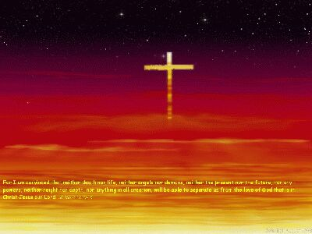
十字架

Slide 31
十字架
求主使我靠十架，在彼有生命水；
寶血由十架流下，白白賜人洗罪。
Jesus, keep me near the cross-
there a precious fountain,
Free to all, a healing stream,
flows from Calvary’s mountain.

Slide 32
十字架
十字架，十字架，永是我的榮耀，
我眾罪都洗清潔，唯靠耶穌寶血。
In the cross, in the cross,
be my glory ever,
till my raptured soul shall
find rest beyond the river

Slide 33
十字架
我來到主十架前，蒙救主的愛憐；
衪賜我聖靈亮光，照亮我的心田。
At the cross I stood one day,
love and mercy found me;
There the bright and morning star
shed its beams around me

Slide 34
十字架
十字架，十字架，永是我的榮耀，
我眾罪都洗清潔，唯靠耶穌寶血。
In the cross, in the cross,
be my glory ever,
till my raptured soul shall
find rest beyond the river

Slide 35
十字架
求主使我靠十架，思念昔日情景；
常在十架蔭庇下，緊緊跟主前行。
Near the cross! O Lamb of God, Bring its scenes before m ;
Help me walk from day to day with its shadow over me.

Slide 36
十字架
十字架，十字架，永是我的榮耀，
我眾罪都洗清潔，唯靠耶穌寶血。
In the cross, in the cross,
be my glory ever,
till my raptured soul shall
find rest beyond the river

Slide 37
十字架
儆醒等候十架前，盼望信心加增；
直到走完世路程，天家永享安穩。
Near the cross I’ll watch and wait,
hoping trusting ever,
‘til I reach the golden strand
just beyond the river

Slide 38
十字架
十字架，十字架，永是我的榮耀，
我眾罪都洗清潔，唯靠耶穌寶血。
In the cross, in the cross,
be my glory ever,
till my raptured soul shall
find rest beyond the river

Slide 39
讀 經 Scripture Reading
路加福音十九章1-10節
Luke 19:1-10

Slide 40
19:1 耶穌進了耶利哥、正經過的時候、
19:2 有一個人名叫撒該、作稅吏長、是個財主。
19:1 Jesus was going through
the city of Jericho.
19:2 In Jericho there was a man
named Zacchaeus. He was
a wealthy, very important
tax collector.
Notes:
40

Slide 41
19:3 他要看看耶穌是怎樣的人．只因人多、
他的身量又矮、所以不得看見。
19:4 就跑到前頭、爬上桑樹、要看耶穌、
因為耶穌必從那裏經過。
19:3 He wanted to see who Jesus was.
There were many others who wanted to
see Jesus too. Zacchaeus was too short
to see above the people.
19:4 So he ran to a place where he knew Jesus
would come. Then he climbed a
sycamore tree so he could see him.
Notes:
41

Slide 42
19:5 耶穌到了那裏、抬頭一看、對他說、
撒該、快下來、今天我必住在你家裏。
19:6 他就急忙下來、歡歡喜喜的接待耶穌。
19:5 When Jesus came to where Zacchaeus
was, he looked up and saw him in the tree.
Jesus said, "Zacchaeus, hurry! Come
down! I must stay at your house today."
19:6 Zacchaeus hurried and came down.
He was happy to have Jesus in his house.
Notes:
42

Slide 43
19:7 眾人看見、都私下議論說、
他竟到罪人家裏去住宿。
19:8 撒該站著、對主說、主阿、
我把所有的一半給窮人．
我若訛詐了誰、就還他四倍。
19:7 Everyone saw this. They began to
complain, "Look at the kind of man Jesus
is staying with. Zacchaeus is a sinner!"
19:8 Zacchaeus said to the Lord, "I want to do
good. I will give half of my money to the
poor. If I have cheated anyone, I will pay
them back four times more."
Notes:
43

Slide 44
19:9 耶穌說、今天救恩到了這家、
因為他也是亞伯拉罕的子孫。
19:10 人子來、為要尋找拯救失喪的人。
19:9 Jesus said, "Today is the day for this
family to be saved from sin. Yes,
even this tax collector is one of God's
chosen people.
19:10 The Son of Man came to find
lost people and save them."
Notes:
44

Slide 45
證道Preaching
信心與恩典
Faith and Grace

Slide 46
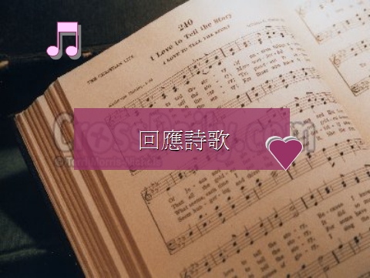

Slide 50
Carrollton Chinese Church
佳 樂 頓 華 人 教 會
歡迎與報告

Slide 51
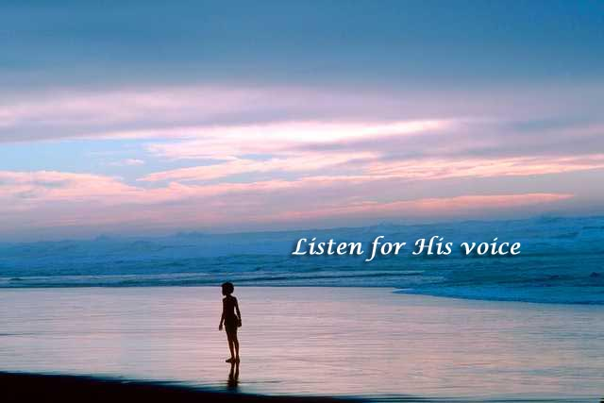
主 禱 文
我們在天上的父：
願人都尊你的名為聖。願你的國降臨。願你的旨意行在地上，如同行在天上。我們日用的飲食，今日賜給我們,免我們的債，如同我們免了人的債。不叫我們遇見試探.救我們脫離兇惡。因為國度、權柄、榮耀，全是你的，直到永遠。阿們
Our Father in heaven, hallowed be your name.
Your Kingdom come, your will be done,
on earth as in heaven. Give us today our daily bread. Forgive us our sins, as we forgive those who sin against us. Lead us not into temptation, but deliver us from evil. For the kingdom, the power and the glory are yours.
Now and for ever. Amen.

Slide 52
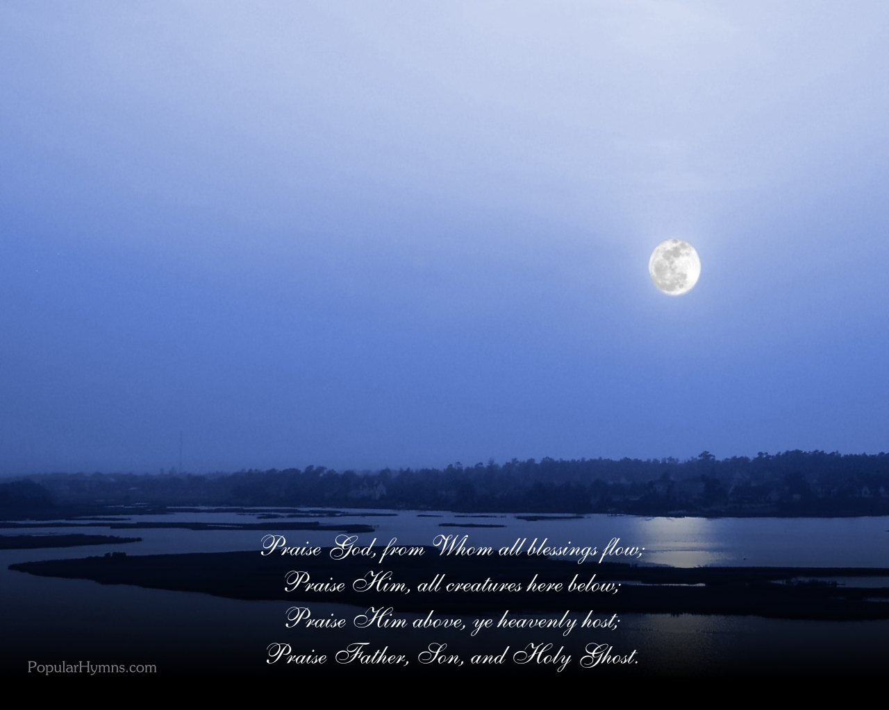
三一頌
讚美真神萬福之根；
Praise God, from whom all blessing flow;
世上萬民讚美主恩；
Praise Him, all creatures here below;
天使天軍讚美主名；
Praise Him above ye heavenly host;
讚美聖父，聖子，聖靈。阿門。
Praise Father, Son and Holy Ghost, Amen;

Slide 53
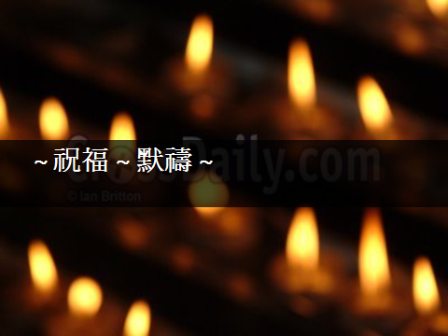
~ 祝福 ~ 默禱 ~

